Slide 1





#AzureFamily
JackTracey.co.uk
Jack_Ref
jtracey93
Azure Governance

Slide 2

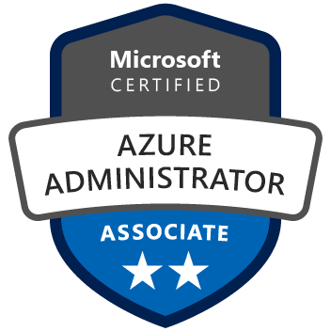
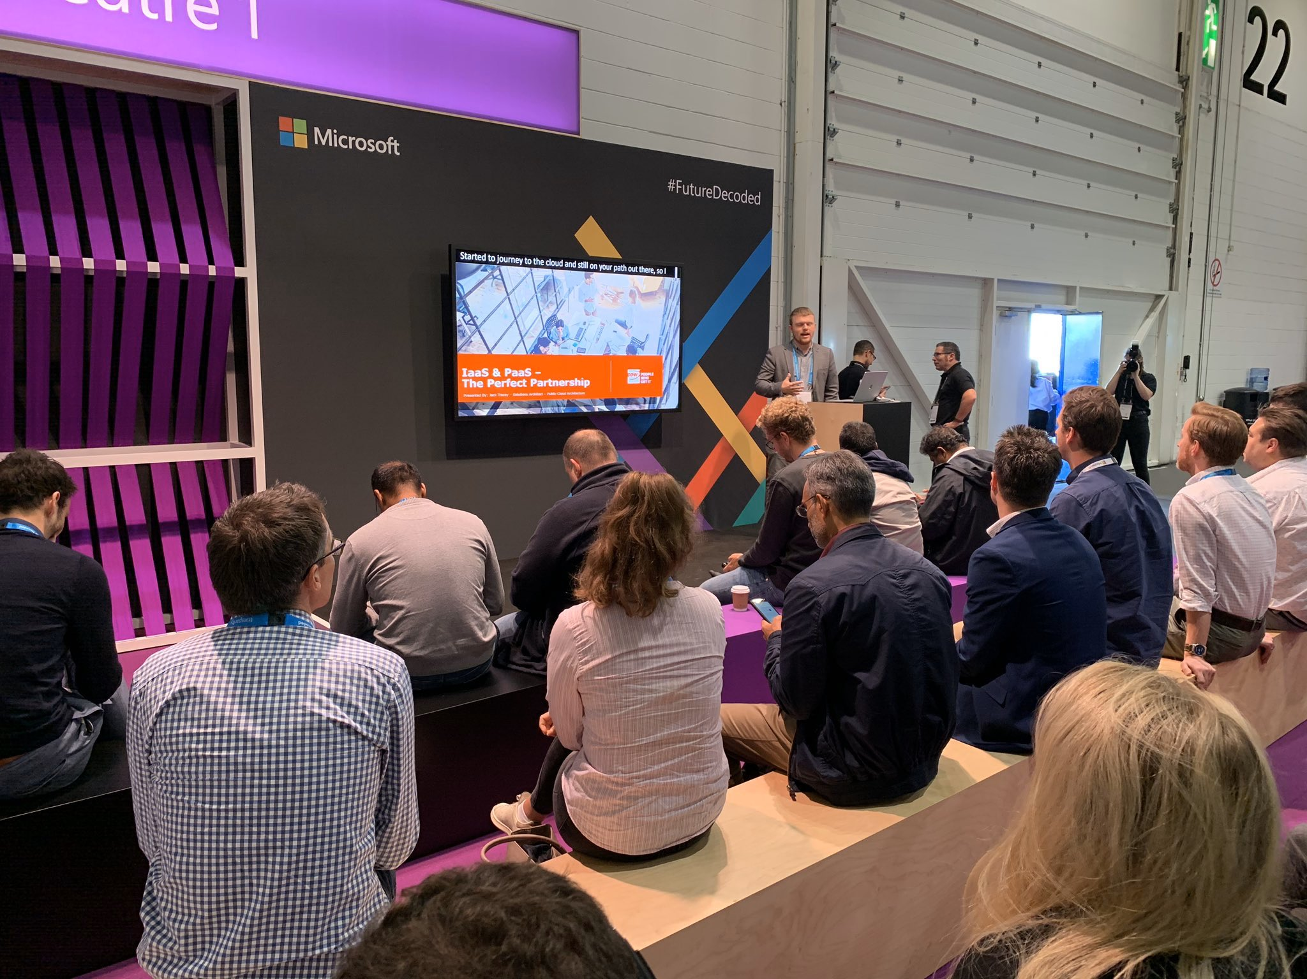




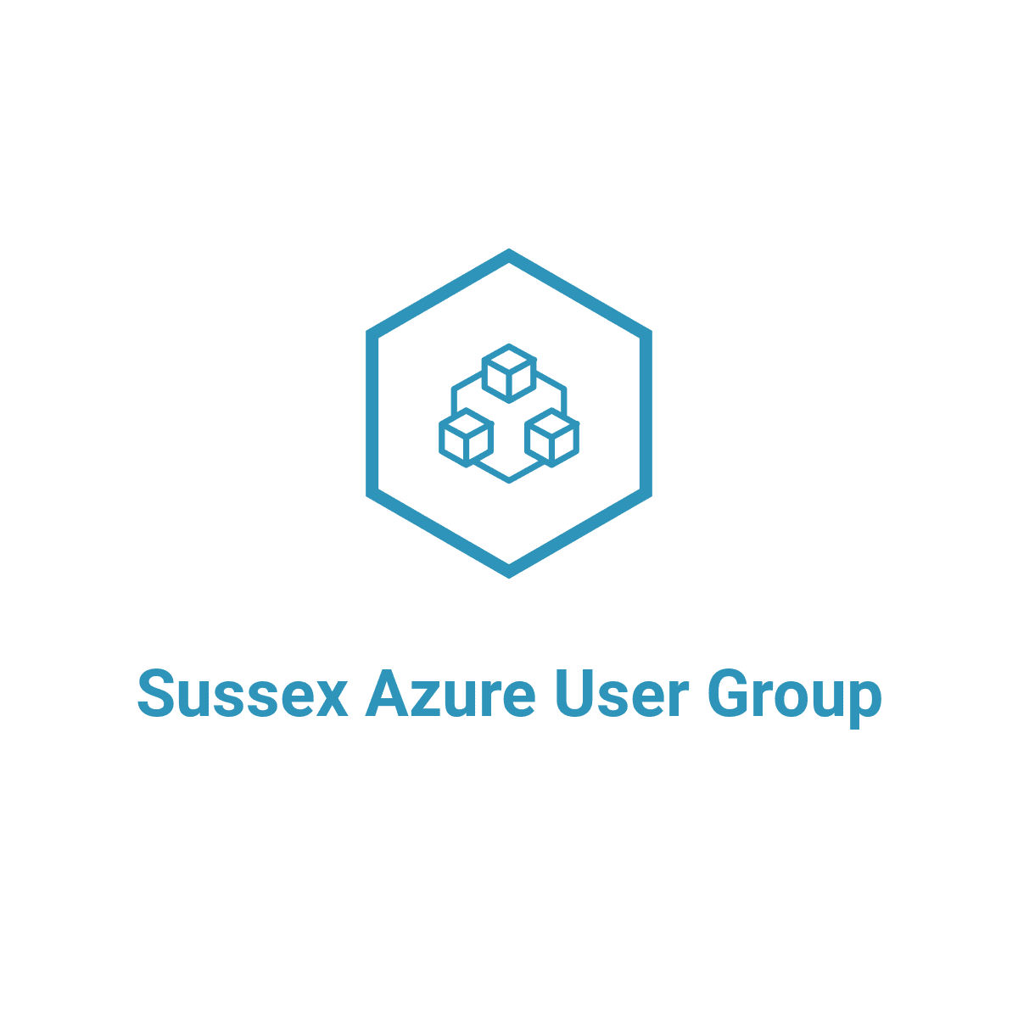

About Me – Jack Tracey
Solutions Architect – Public Cloud Architecture
Co-Founder of Sussex Azure User Group (Brighton)
JackTracey.co.uk
Jack_Ref
jtracey93
SussexAzure.uk
SussexAzure
SussexAzure

Slide 3







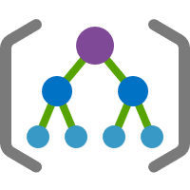
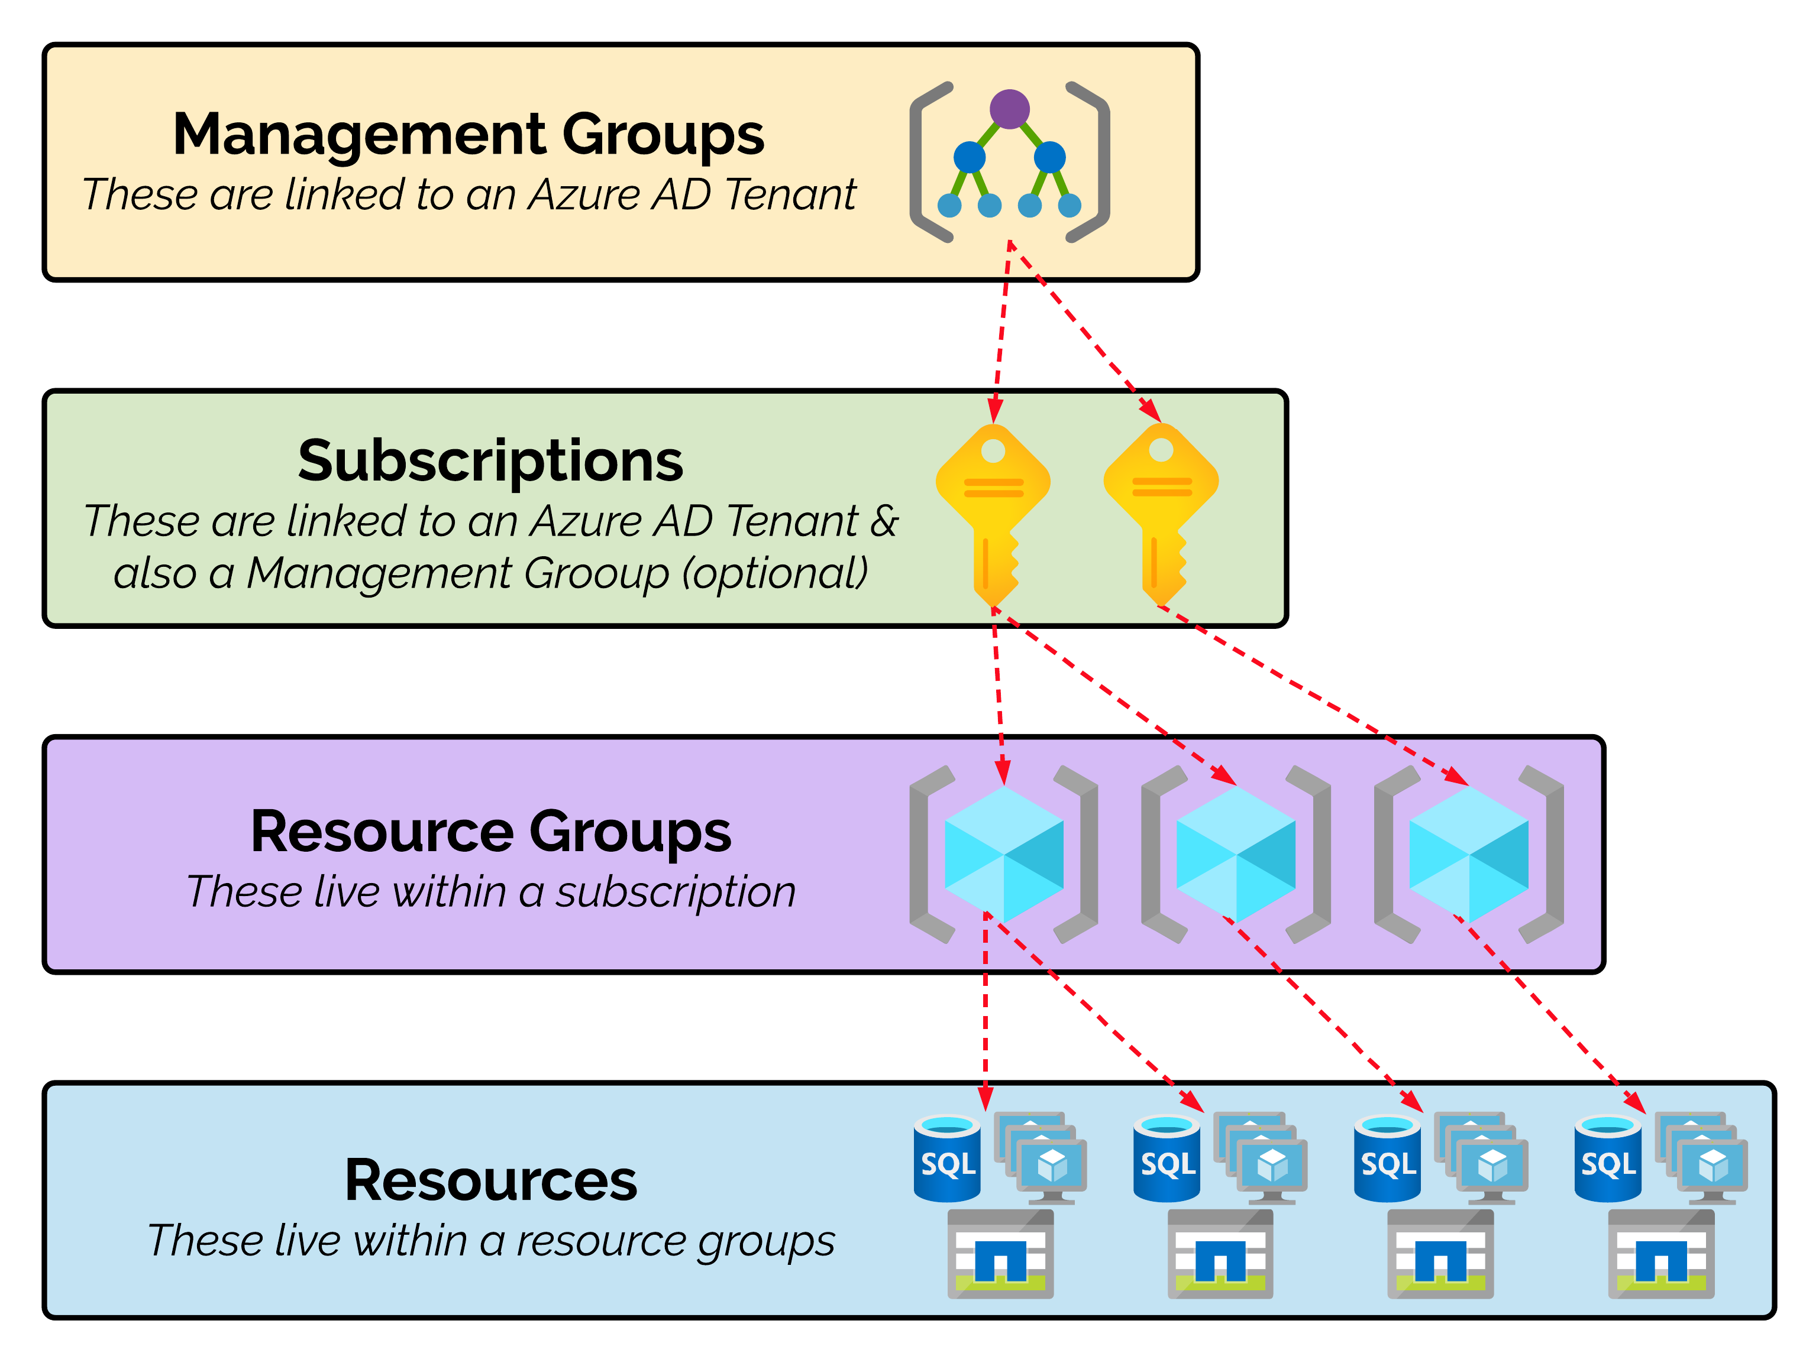
Topics We Are Going To Cover…
Tags & Tagging
Naming Schemes
Azure Governance Scopes
Management Groups
Role Based Access Control (RBAC)
Azure Policy
Azure Blueprints
DEMO

Slide 4
Tags & Tagging
Key/Name-Value Pairs
Just additional metadata
Azure refers to ‘Key’ as ‘Name’
Supported by most resources
Up-to-date list: https://jacktracey.co.uk/tagsupport
50 tags per resource/resource group limit
Only 15 tags allowed on storage accounts currently
Tag names can be up to 512 characters in length
Only 128 characters on storage accounts
Cannot contain following characters: < > % \ ? /
Tag values can be up to 256 characters in length
Tags cannot be applied to ‘Classic’ Azure Resources
Name: Cloud
Value: Azure

Slide 5
My Recommended Tags
Key | Value
Environment | e.g. Production
IT-Owner-Contact | e.g. John Smith – john.smith@abcxyz.com
Business-Owner-Contact | e.g. Jane Doe – jane.doe@abcxyz.com
Hours-Operational | e.g. 24x7 or 0800-1800
Days-Operational | e.g. Everyday,Weekdays or Monday
Application-Taxonomy | e.g. UK:Finance:Payroll:SagePayrollV12
Service-Application | e.g. Sage Payroll
Billed-To | e.g. Finance
Build-Date-Time | e.g. 2019-11-27-20:00
Cost-Centre | e.g. abc2759
Name: Cloud
Value: Azure

Slide 6
Azure Governance Scopes

Slide 7
Management Groups
Used to group Subscriptions together for simplified management
Can be used for the following Azure Services/Features:
Role-Based Access Control (RBAC)
Azure Policy
Azure Blueprints
Azure Cost Management
Can only be nested up to 6 levels deep
This excludes the Root Management Group
1 to 1 relationship between a Subscription & a Management Group
e.g. A Subscription can only be a member of 1 Management Group at any one time
Management Groups are within an Azure AD Tenant and therefore can only contain subscriptions from the same Azure AD Tenant.

Slide 8
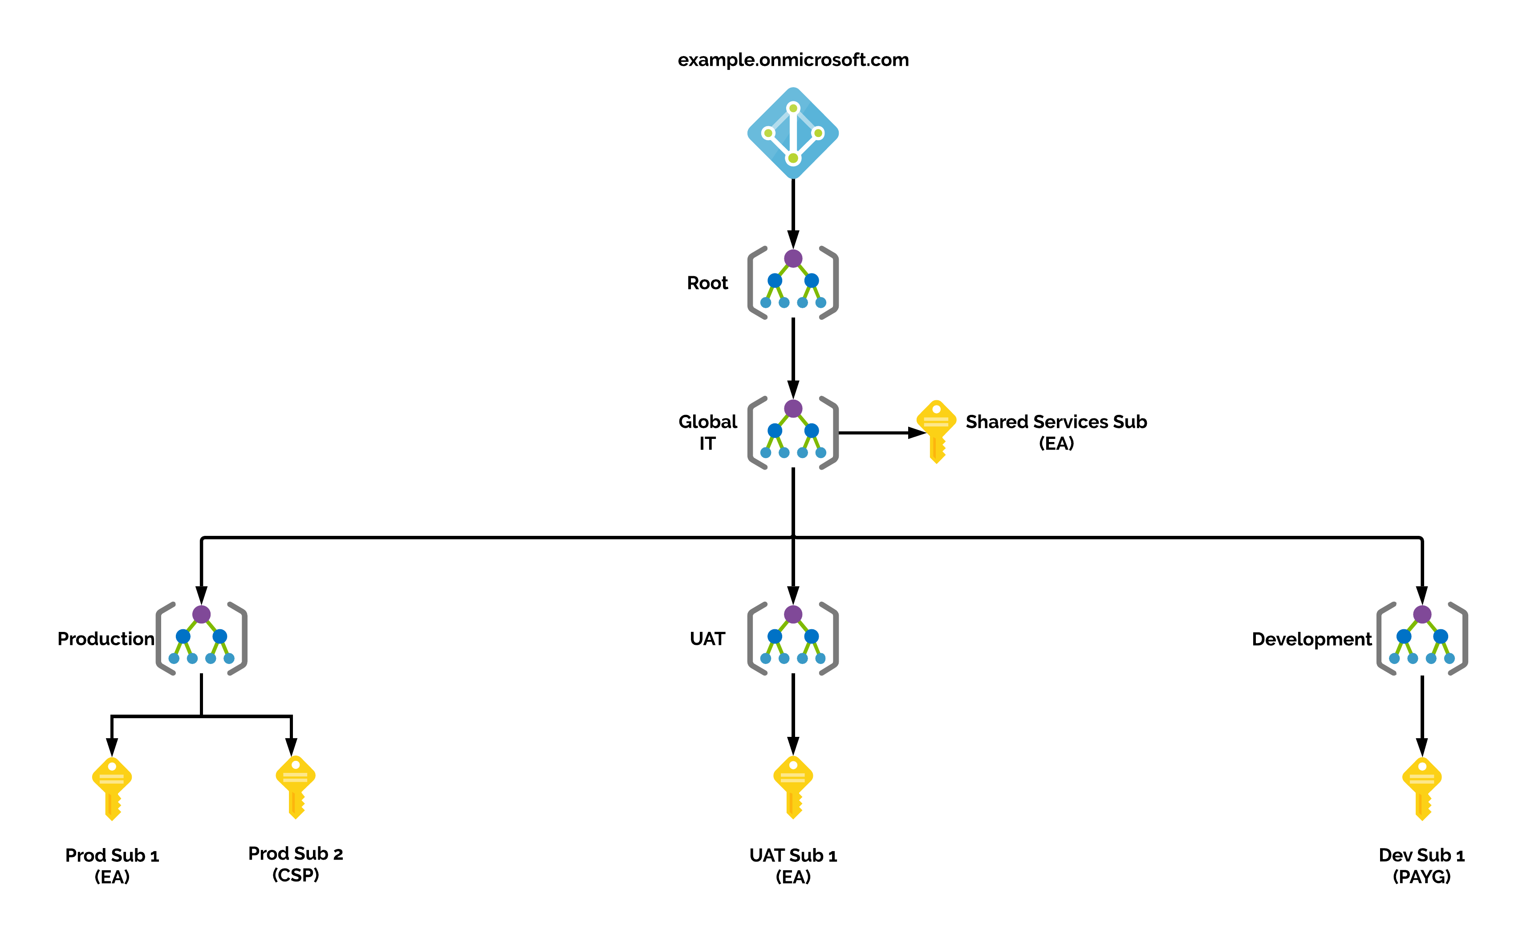
Management Group Example Architectures

Slide 9
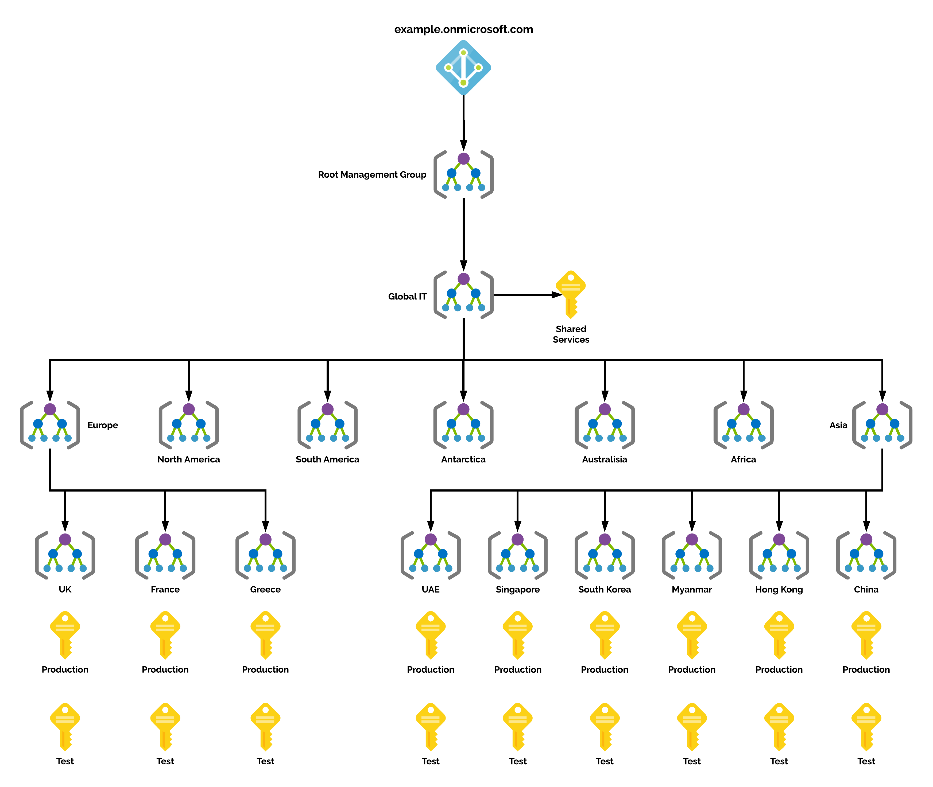
Management Group Example Architectures

Slide 10
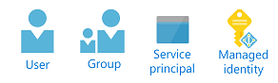
Role-Based Access Control (RBAC)
Access Management / Permissions Control for Azure Resources
Applied to Users, Groups, Service Principals or Managed Identities
Different to Azure AD Roles
e.g. Global Administrator or Exchange Administrator
Can be applied at all Azure Governance Scope levels
e.g. Management Group, Subscription, Resource Group or Resource
Over 70+ Built-in Roles - https://jacktracey.co.uk/azurerbacroles
Custom Roles can also be created if a built-in one does not meet requirements
Not supported by Management Groups yet
4 Fundamental Roles
Owner – Full access to all resources & CAN assign RBAC Roles for other users
Contributor – Full access to all resources but CANNOT assign RBAC Roles for other users
Reader – Read access to all resources
User Access Administrator – No access to resources but CAN manage user access/RBAC role assignments

Slide 11


Role-Based Access Control (RBAC)
RBAC role assignments are automatically inherited downwards from the Azure Governance Scope level they are applied to!

Slide 12

RBAC – Tips & Best Practice
Use the Least-Privilege Administrative model
Use Built-in RBAC Roles wherever possible
Use Azure AD Groups instead of users wherever possible
Use the Azure Governance Scopes to simplifying assignments
Only use Deny Assignments where absolutely required
Increased numbers of these types of assignments can make it difficult for troubleshooting RBAC permissions
Ensure users with any level of Create, Update or Delete permissions have MFA enabled on their User account
This may require additional licensing for Azure AD Premium features

Slide 13
Azure Policy
Tool to help your Azure environment stay compliant with your policies
Used by Azure Security Center
Use to apply “guardrails” instead of becoming a blocker
Can check both the Azure Platform & inside the OS of a VM
Key Terms: Definitions, Initiatives, Assignments
Can be applied to Management Groups, Subscriptions & Resource Groups
Exclusions can also be made to assist with requirements
Defined as JSON files
Visual Studio Code Extension Available

Slide 14


Azure Policy Effects
Append
Used at resource Creation or Update to add additional properties to the deployment
e.g. Add public IP addresses to Storage Account firewall rules
Audit
Used after a successful resource Creation or Update to audit properties and resources but not stop the deployment
e.g. Just checking what's being deployed but not restricting
Deny
Used at resource Creation or Update to audit properties and resources and stop the deployment if the policy is matched
e.g. Just checking what’s going to be deployed/updated and stopping it if it matches the policy
AuditIfNotExists
Used at resource Creation or Update to audit properties but not stop the deployment to see if specific properties/values are missing
e.g. Just checking what's being deployed and missing, but not restricting

Slide 15
Azure Policy Effects
DeployIfNotExists
Very similar to AuditIfNotExists
Used after a successful resource Creation or Update to audit properties/values but not stop the deployment to see if specific properties/values are missing. And if they are missing then deploy another template to put the properties/values in place
e.g. An Azure SQL DB has been deployed successfully but TDE is not enabled, this mode will enable TDE
Disabled
Used for testing policies when the policy has a parameterised effect
Allows you to disable a single assignment instead of all the policies assignments
Could also set ‘encforcementMode’ to ‘Disabled’ on assignment to achieve similar outcome
Modify
Can only be used for tags at the moment during the creation or update of a resource

Slide 16


Azure Blueprints
Bundle your RBAC definitions, Azure Policy definitions & ARM Templates together in an Azure Blueprint definition
Role-based access controls
Policy Definitions
Subscription A EA
ARM Templates
Azure Blueprints
Subscription B CSP
Subscription C PAYG
…

Slide 17
#AzureFamily
JackTracey.co.uk
Jack_Ref
jtracey93
DEMO TIME

Slide 18
#AzureFamily
JackTracey.co.uk
Jack_Ref
jtracey93
ARM Templates

Slide 19

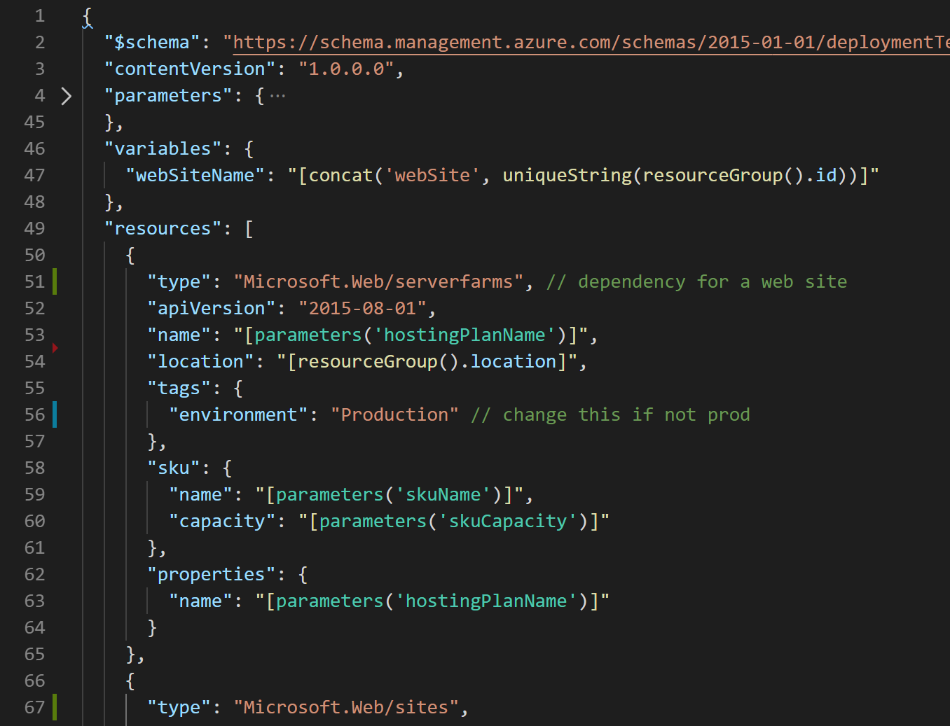
What Are ARM Templates…?
JSON files
Declarative
Only work in Azure

Slide 20
Declarative Vs Imperative
Declarative
Imperative

Slide 21
Complete
ARM Deployment Modes
Incremental
Notes:
Complete Mode
In complete mode, Resource Manager deletes resources that exist in the resource group but aren't specified in the template.
Only root-level templates support the complete deployment mode. For linked or nested templates, you must use incremental mode.
Subscription level deployments don't support complete mode.
Currently, the portal doesn't support complete mode.
Incremental Mode
In incremental mode, Resource Manager leaves unchanged resources that exist in the resource group but aren't specified in the template. Resources in the template are added to the resource group.
It's important to note that incremental mode applies to the whole resource, not to individual properties on an existing resource.
When redeploying an existing resource in incremental mode, all properties are reapplied. The properties aren't incrementally added.
A common misunderstanding is to think properties that aren't specified in the template are left unchanged. If you don't specify certain properties, Resource Manager interprets the deployment as overwriting those values.

Slide 22



ARM Deployment Scopes
Preview for PowerShell & AZ CLI
Technically

Slide 23
ARM Template Terminology
ARM Terminology
JSON
Parameters
Variables
Functions
Resources
Outputs

Slide 24
ARM Parameters
"parameters": {
"adminUsername": {
"type": "string",
"metadata": {
"description": "Username for the Virtual Machine." }
},
"adminPassword": {
"type": "securestring",
"metadata": {
"description": "Password for the Virtual Machine."
}
}
}

Slide 25
ARM Variables
"variables": {
"nicName": "myVMNic",
"addressPrefix": "10.0.0.0/16",
"subnetName": "Subnet",
"subnetPrefix": "10.0.0.0/24", "publicIPAddressName": "myPublicIP", "virtualNetworkName": "MyVNET"
}

Slide 26
ARM Functions
"functions": [
{
"namespace": "tailwindtraders",
"members": {
"uniqueName": {
"parameters": [
{
"name": "namePrefix",
"type": "string"
}
],
"output": {
"type": "string",
"value": "[concat(toLower(parameters('namePrefix')), uniqueString(resourceGroup().id))]"
}
}
}
}
],
Notes:
https://samcogan.com/user-defined-functions-in-arm-templates/

Slide 27
ARM Resources
{
"type": "Microsoft.Network/publicIPAddresses", "name": "[variables('publicIPAddressName')]", "location": "[parameters('location')]",
"apiVersion": "2018-08-01",
"properties": {
"publicIPAllocationMethod": "Dynamic", "dnsSettings": {
"domainNameLabel": "[parameters('dnsLabelPrefix')]"
}
}
}

Slide 28
ARM Outputs
"outputs": {
"hostname": {
"type": "string",
"value": "[reference(variables('publicIPAddressName')).dnsSettings.fqdn]"
} }

Slide 29
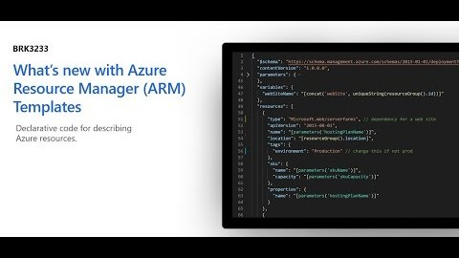
ARM Template What-If

Slide 30
ARM Template Toolkit

Slide 31
#AzureFamily
JackTracey.co.uk
Jack_Ref
jtracey93
DEMO TIME

Slide 32
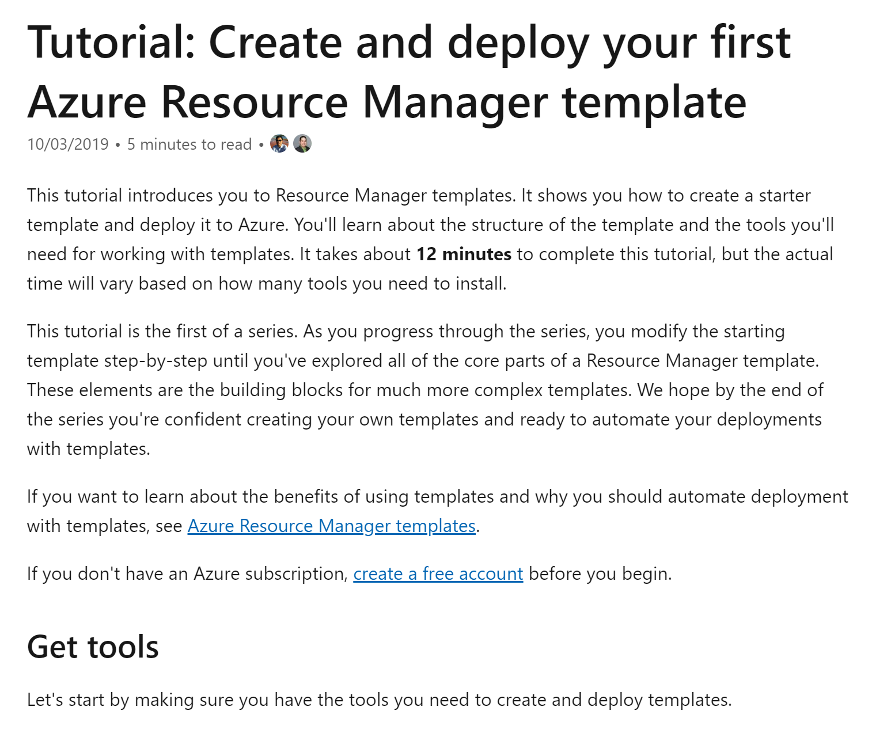
New To ARM Templates…?
aka.ms/justLearnARM

Slide 33

Community Event - Azure Spring Clean
https://www.azurespringclean.com

Slide 34
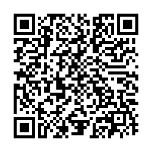
#AzureFamily
JackTracey.co.uk
Jack_Ref
jtracey93
THANK YOU

